Slide 1
Unit III

Slide 2
Polynomials

Slide 3


Slide 5


Slide 6
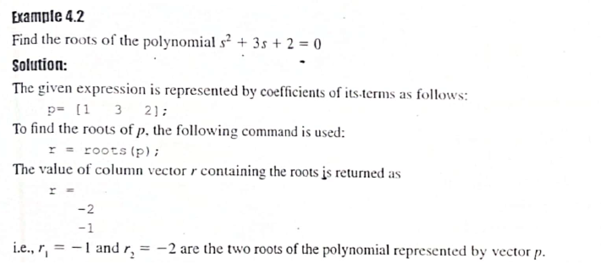

Slide 8



Slide 9
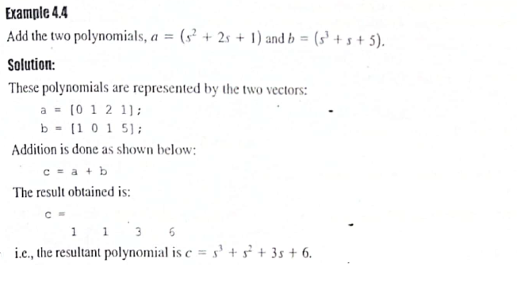

Slide 10
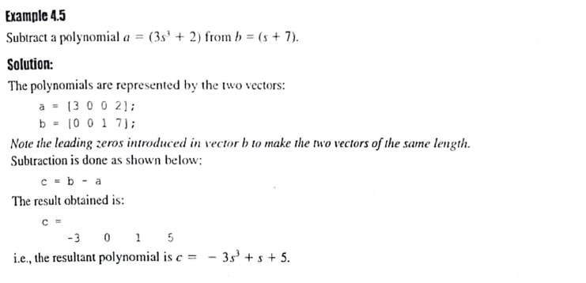

Slide 11


Slide 14


Slide 17


Slide 18
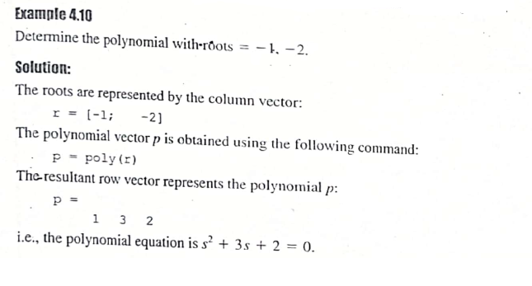

Slide 20
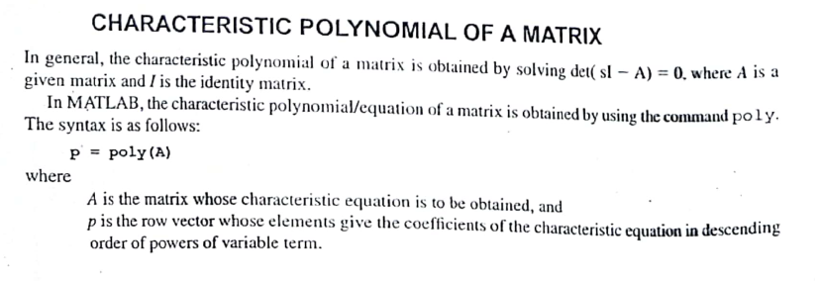

Slide 22
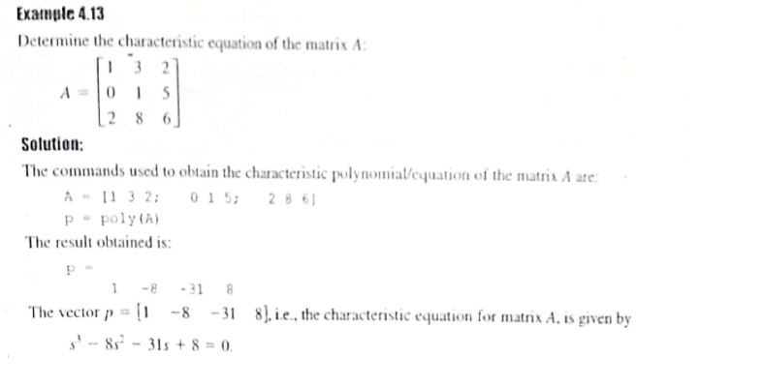

Slide 23


Slide 24


Slide 25
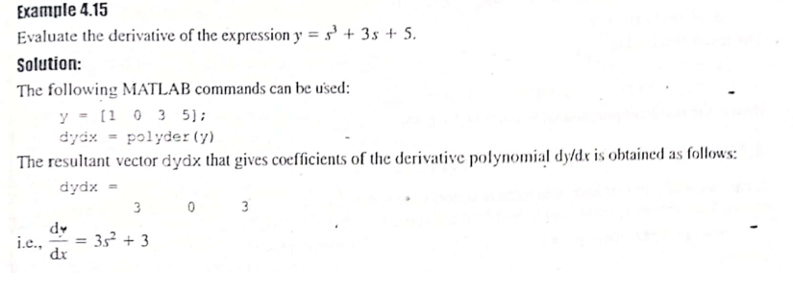

Slide 26


Slide 28
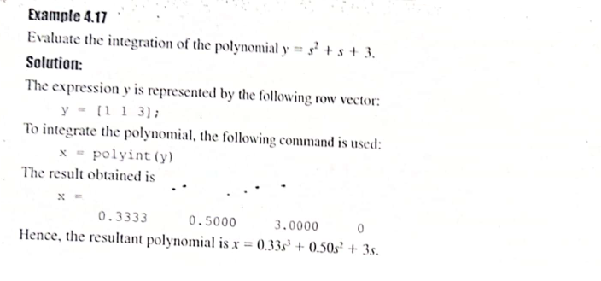

Slide 29


Slide 30
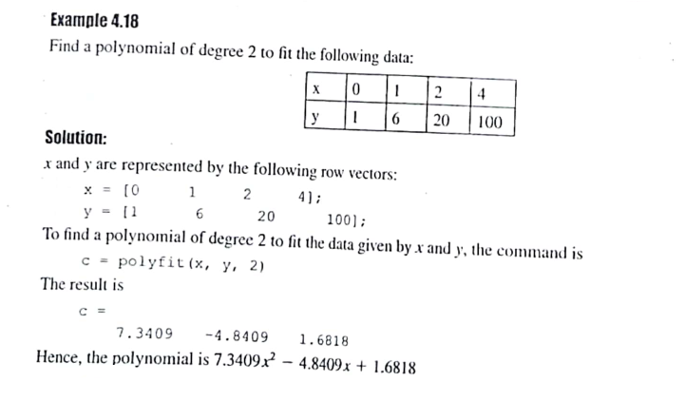

Slide 32


Slide 33
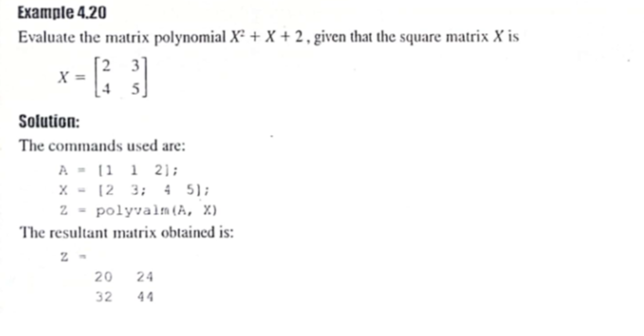

Slide 34


Slide 36

Linear Algebra

Slide 37
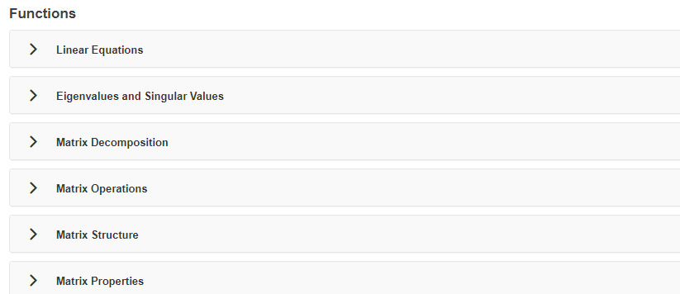

Slide 38


Slide 39
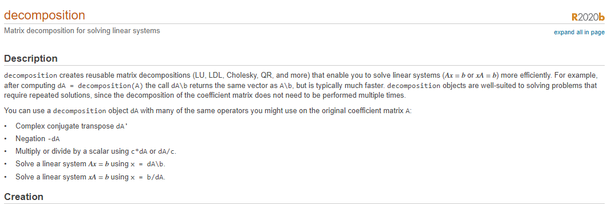
Matrix Decomposition

Slide 40
